Slide 1
Inheritance
Course Code: CSC1102 &1103
Course Title: Introduction to Programming
Dept. of Computer Science
Faculty of Science and Technology
Lecturer No: |  | Week No: |  | Semester: | 2020-2021, Summer
Lecturer: | MD. MAZID-UL-HAQUE

Slide 2
Lecture Outline
Single Inheritance
Multilevel Inheritance
Multiple Inheritance
Hierarchical Inheritance
Hybrid Inheritance

Slide 3
C++ Single Inheritance Definition of Single Inheritance
If a single class is derived from one base class then it is called Single Inheritance. In C++ single inheritance base and derived class exhibit one to one relation.

Slide 4
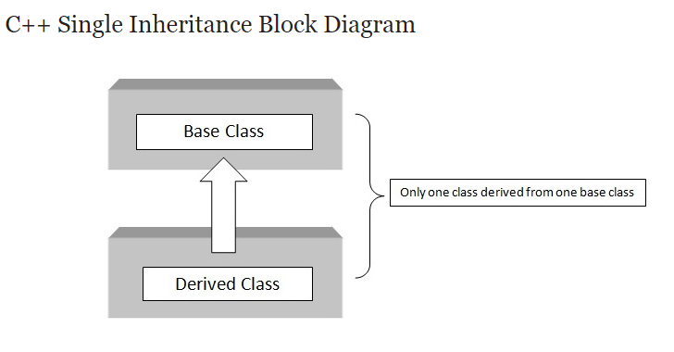
C++ Single Inheritance… cntd Single Inheritance: Block Diagram
As shown in the figure, in C++ single inheritance only one class can be derived from the base class.
Based on the visibility mode used or access specifier used while deriving, the properties of the base class are derived. Access specifier can be private, protected or public.

Slide 5
C++ Single Inheritance…cntd Single Inheritance: Syntax
class A // Base class
{
..........
};
class B : access_specifier A // Derived class
{
...........
} ;

Slide 6
C++ Multilevel Inheritance Definition of Multilevel Inheritance
If a class is derived from another derived class then it is called Multilevel Inheritance.
For example, if we take animals as a base class then mammals are the derived class which has features of animals and then humans are the also derived class that is derived from sub-class mammals which inherit all the features of mammals.

Slide 7
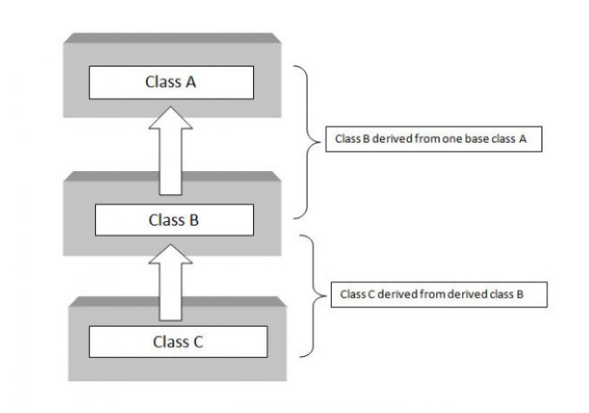
C++ Multilevel Inheritance… cntd Multilevel Inheritance: Block Diagram
As shown in above block diagram, class C has class B and class A as parent classes. Depending on the relation the level of inheritance can be extended to any level.
As in other inheritance, based on the visibility mode used or access specifier used while deriving, the properties of the base class are derived. Access specifier can be private, protected or public.

Slide 8
C++ Multilevel Inheritance… cntd Multilevel Inheritance: Syntax
class A // Base class
{
...........
};
class B : access_specifier A // Derived class
{
...........
} ;
class C : access_specifier B // Derived from derived class B
{
...........
} ;

Slide 9
C++ Multiple Inheritance Definition of Multiple Inheritance
If a class is derived from two or more base classes then it is called Multiple Inheritance. In C++ multiple inheritance a derived class has more than one base class.

Slide 10
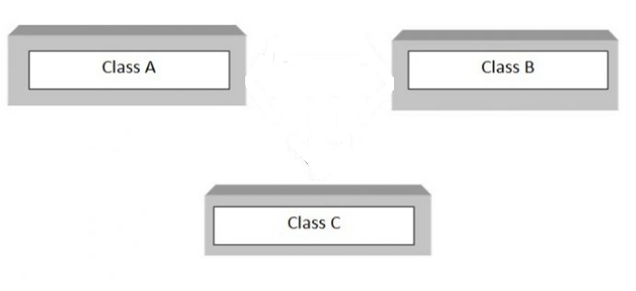
C++ Multiple Inheritance… cntd Multiple Inheritance: Block Diagram
As shown in above block diagram, class C is derived from two base classes A and B.
As in other inheritance, based on the visibility mode used or access specifier used while deriving, the properties of the base class are derived. Access specifier can be private, protected or public.

Slide 11
C++ Multiple Inheritance… cntd Multiple Inheritance: Block Diagram
class A
{
..........
};
class B
{
...........
} ;
class C : access_specifier A, access_specifier A // Derived class from A and B
{
...........
} ;

Slide 12
C++ Hierarchical Inheritance Definition of Hierarchical Inheritance
When several classes are derived from common base class it is called Hierarchical Inheritance.
In C++ hierarchical inheritance, the feature of the base class is inherited onto more than one sub-class.
For example, a car is a common class from which Audi, Ferrari, Maruti etc. can be derived.

Slide 13
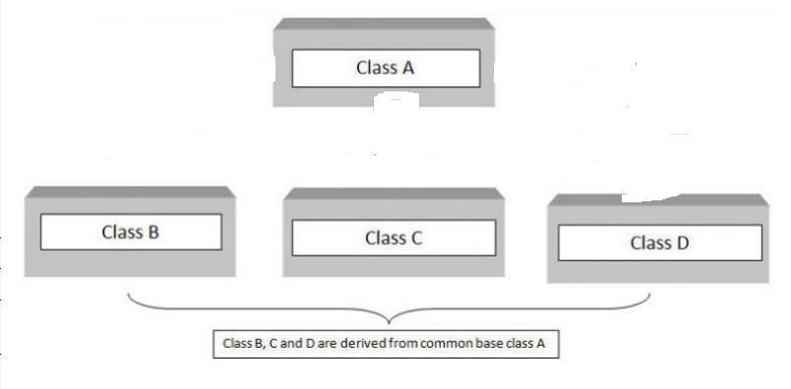
C++ Hierarchical Inheritance… cntd Hierarchical Inheritance: Block Diagram
As shown in above block diagram, in C++ hierarchical inheritance all the derived classes have common base class. The base class includes all the features that are common to derived classes.
As in other inheritance, based on the visibility mode used or access specifier used while deriving, the properties of the base class are derived. Access specifier can be private, protected or public.

Slide 14
C++ Hierarchical Inheritance… cntd Hierarchical Inheritance: Syntax
class A // Base class
{
..............
};
class B : access_specifier A // Derived class from A
{
...........
} ;
class C : access_specifier A //Derived class from A
{
...........
} ;
class D : access_specifier A // Derived class from A
{
...........
} ;

Slide 15
C++ Hybrid Inheritance Definition of Hybrid Inheritance
The inheritance in which the derivation of a class involves more than one form of any inheritance is called Hybrid Inheritance.
Basically C++ hybrid inheritance is combination of two or more types of inheritance. It can also be called multi path inheritance.

Slide 16
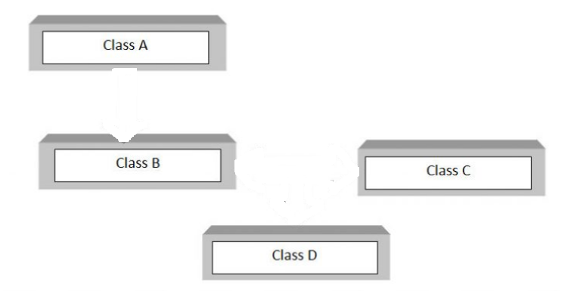
C++ Hybrid Inheritance… cntd Hybrid Inheritance: Block Diagram
Above block diagram shows the hybrid combination of single inheritance and multiple inheritance. Hybrid inheritance is used in a situation where we need to apply more than one inheritance in a program.
As in other inheritance, based on the visibility mode used or access specifier used while deriving, the properties of the base class are derived. Access specifier can be private, protected or public.

Slide 17
C++ Hybrid Inheritance Hybrid Inheritance: Syntax
class A
{
.........
};
class B : public A
{
..........
} ;
class C
{
...........
};
class D : public B, public C
{
...........
};

